Slide 1
WELCOME

Slide 2
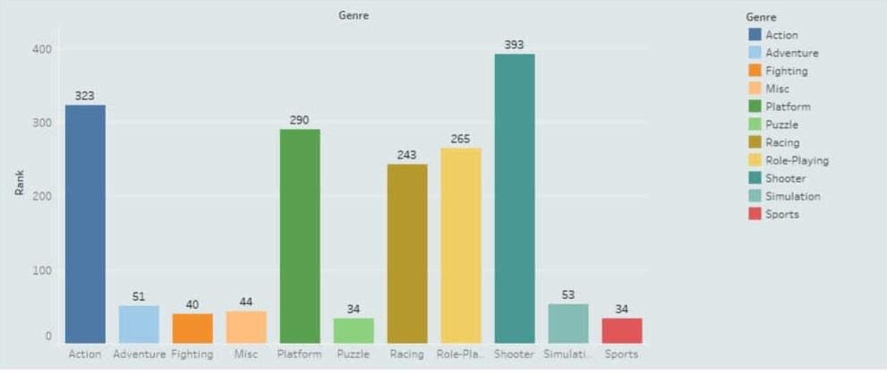
NAAN MUDHALVAN PROJECT
UNCOVERING THE GAMING INDUSTRY’S HIDDEN GEMS: A
COMPREHENSIVE ANALYSIS OF VIDEO GAME SALES

Slide 3
TEAM LEADER:G.PACKIYALAKSHMI TEAM MEMBERS: 1.P.PADMA SHRUTHIKA DEVI 2.R.PARAMESHWARI 3.S.PAVITHRA We all are a team from III B.Sc.,Mathematics, A.K.D.Dharma Raja Women’s College, Rajapalayam.

Slide 4
INTRODUCTION:
Video game sales analysis is the process of collecting and analyzing data about the sales of video games in order to understand market trends and consumer behavior .
This type of analysis can be useful for a variety of purposes ,including identifying the most popular games and genres,predicting future sales,and developing marketing strategies.
Once the data has been collected, it is typically analyzed using Tableau.
The results of the analysis can be used to identify trends and patterns in the market, and to make
Informed decisions about the development and marketing of video games.

Slide 5
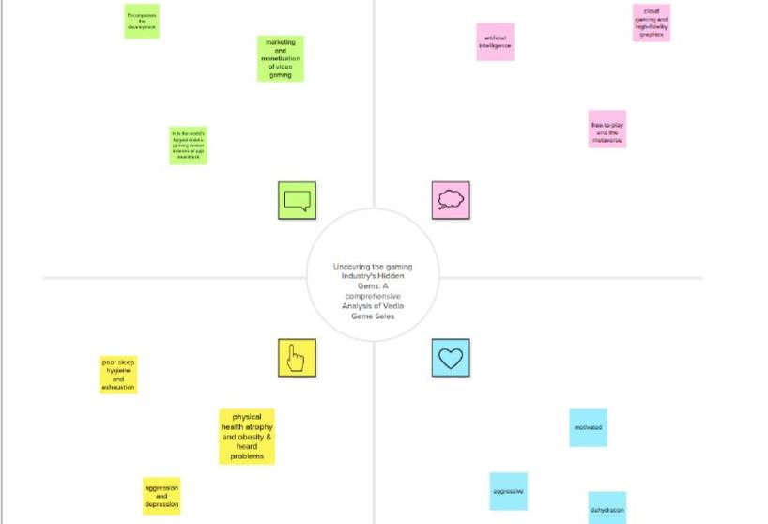
EMPATHY MAP:

Slide 6
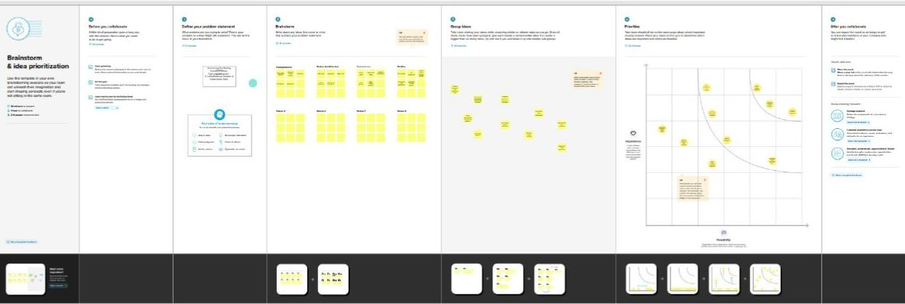
BRAIN STORM:

Slide 7
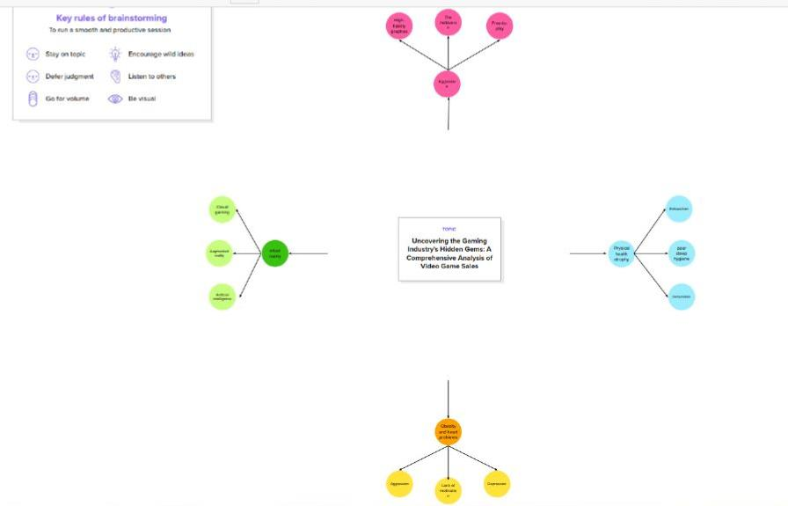
MIND MAP BRAINSTORM:

Slide 8
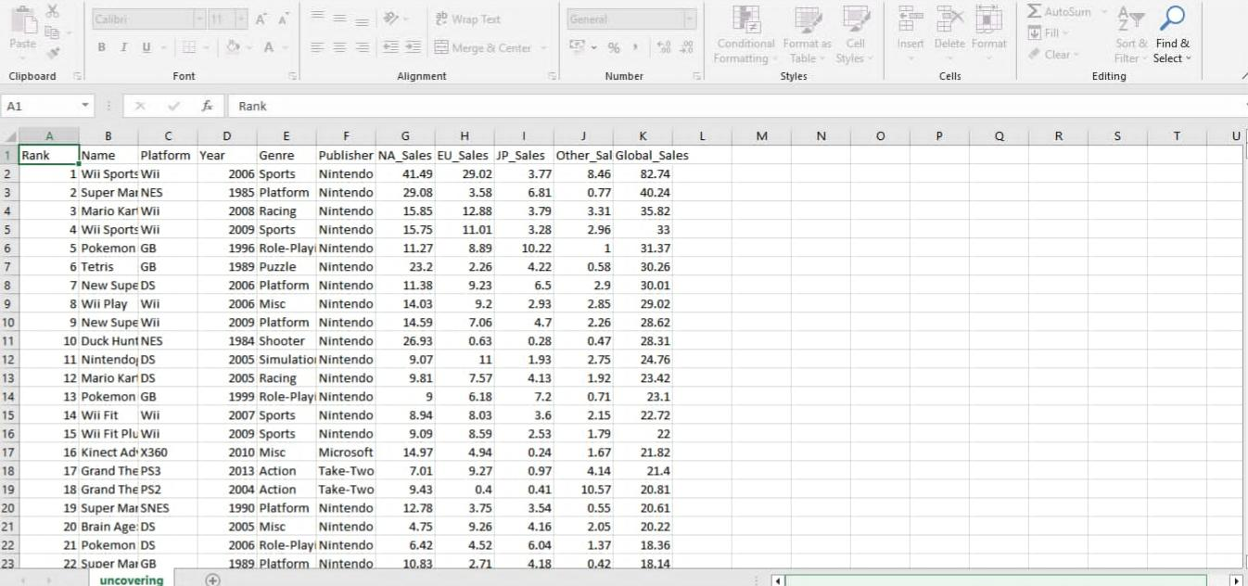
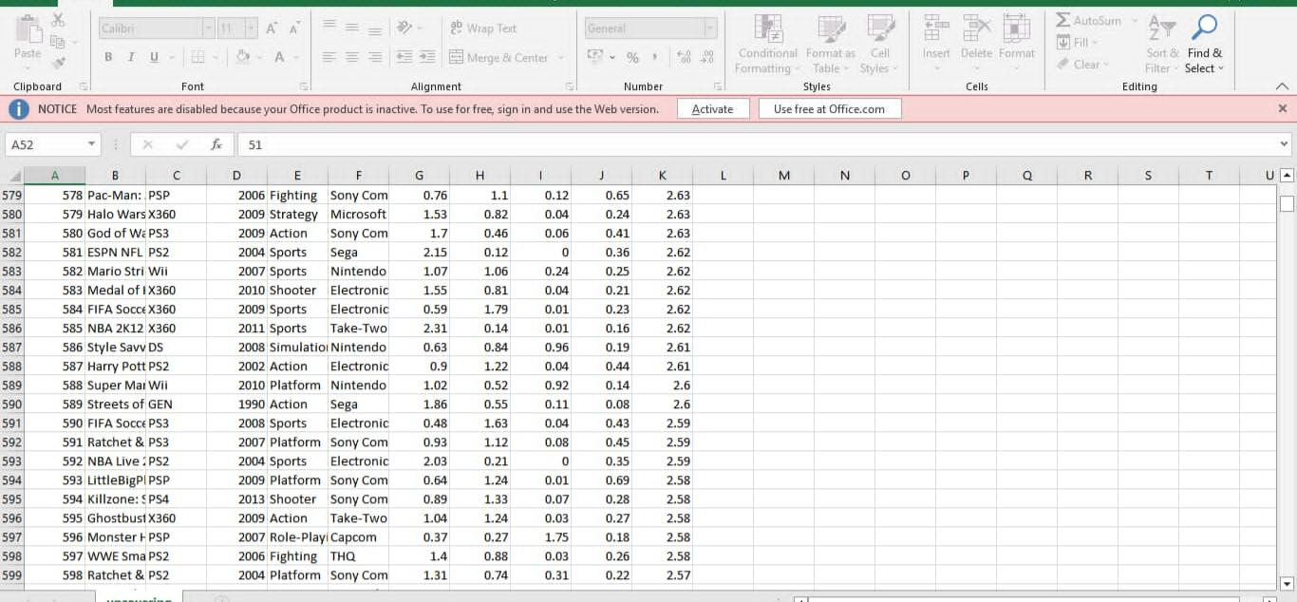
ANALYSING DATA:

Slide 9
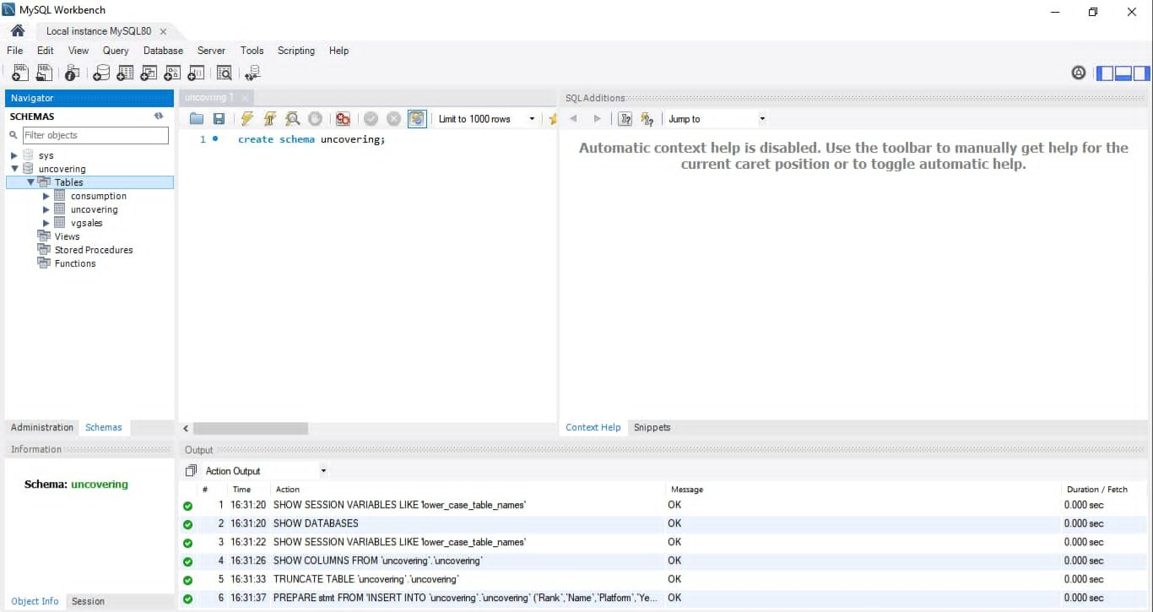
MYSQL WORKBENCH:

Slide 10
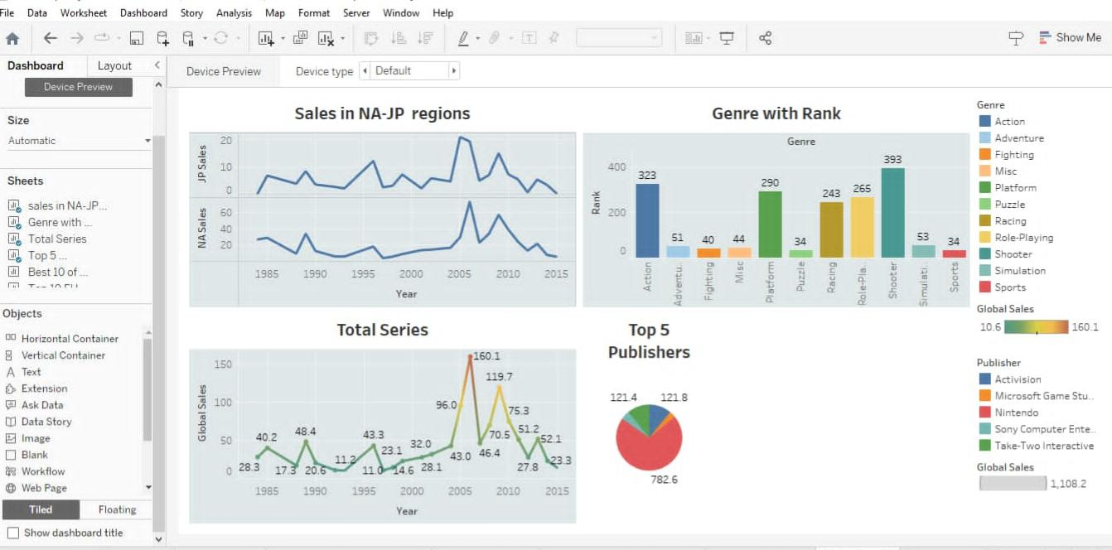
DATA VISUALIZATION:

Slide 11
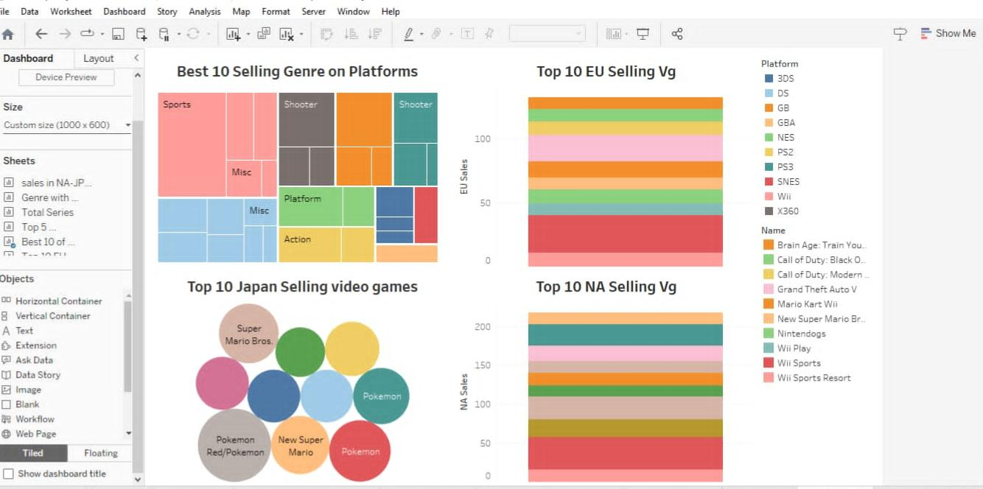
DASHBOARD:

Slide 12
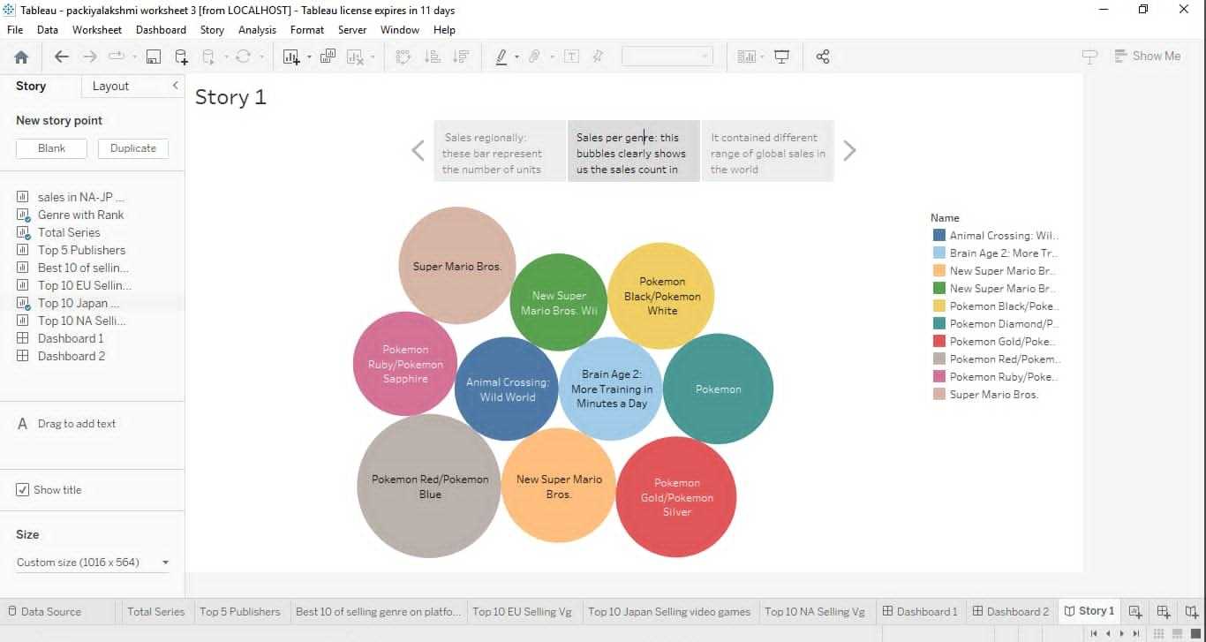
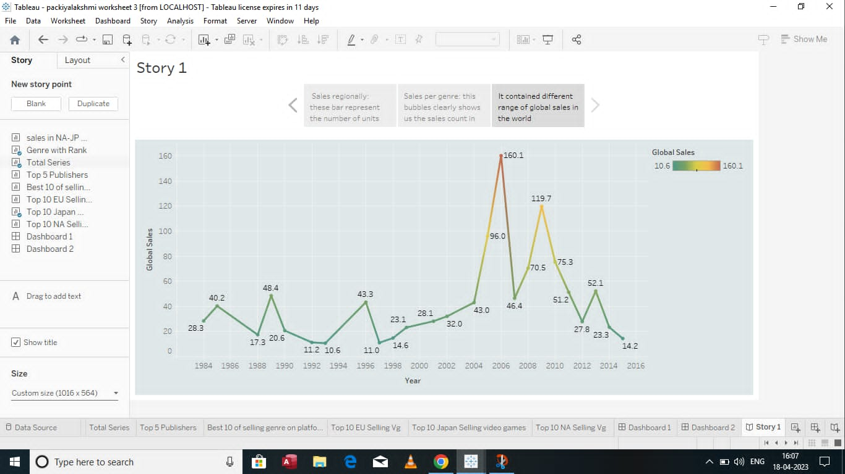
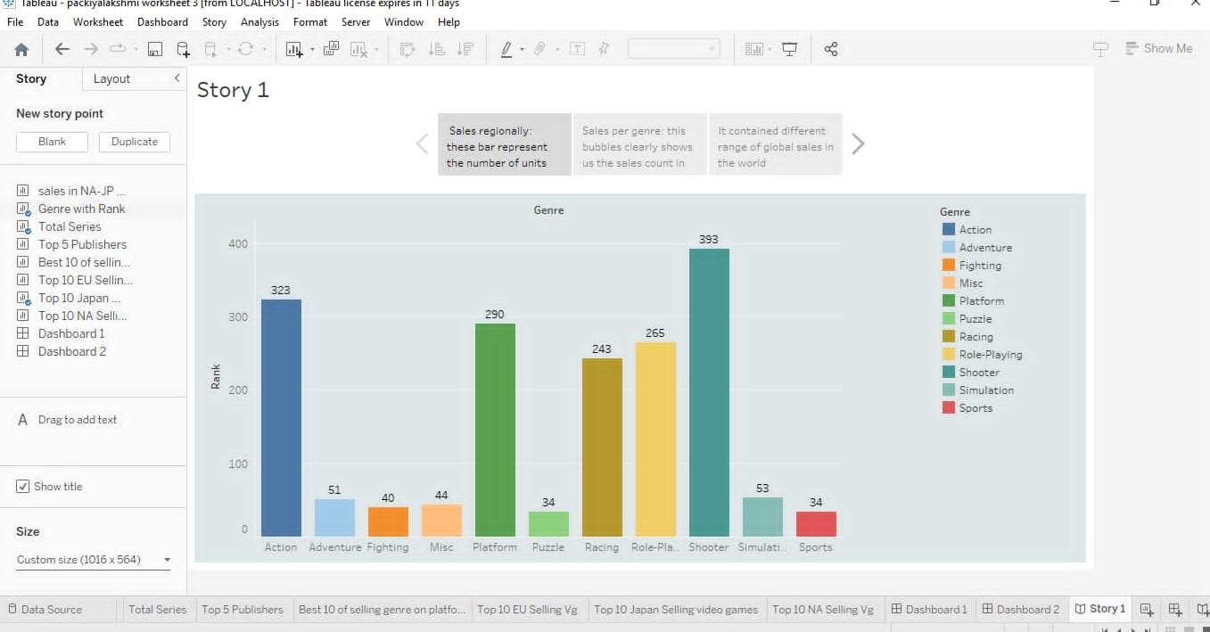
STORY:

Slide 13
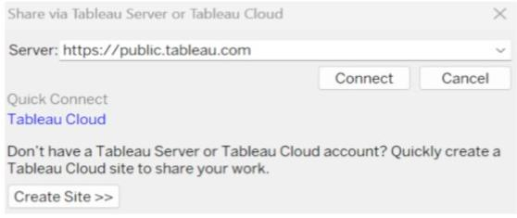
WEB INTEGERATION:

Slide 14
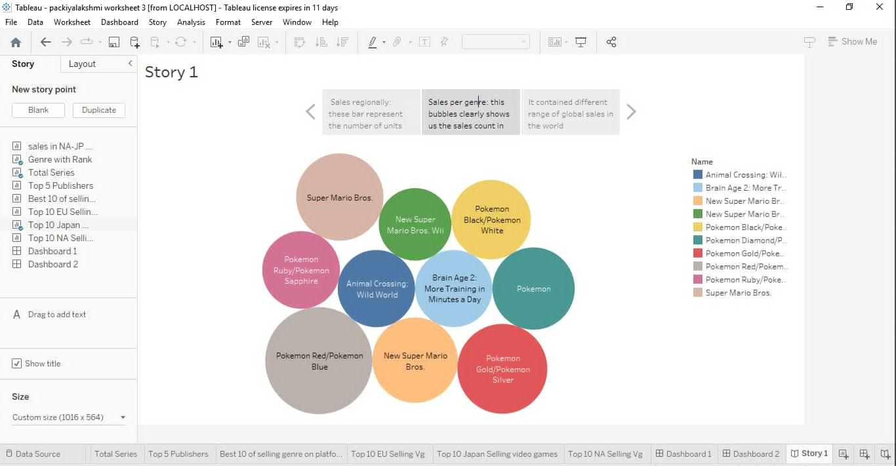
ANALYSIS CHARTS:

Slide 15
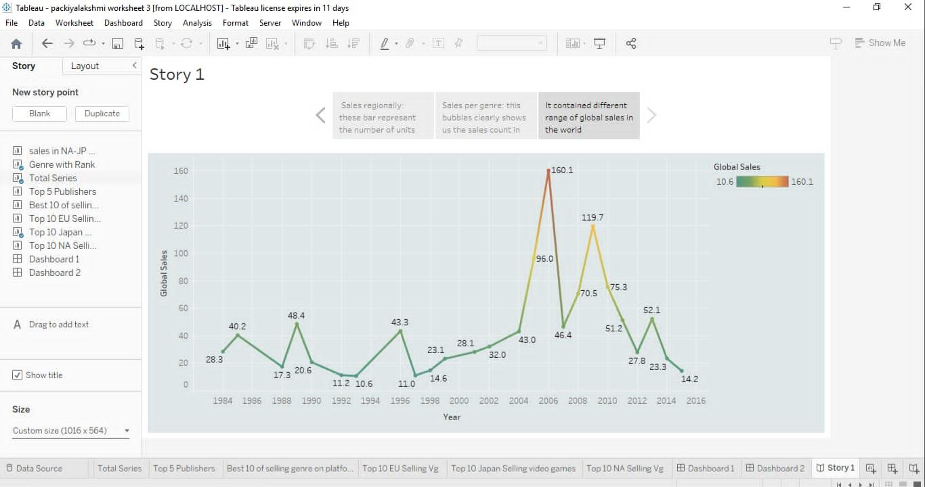

Slide 16


Slide 17
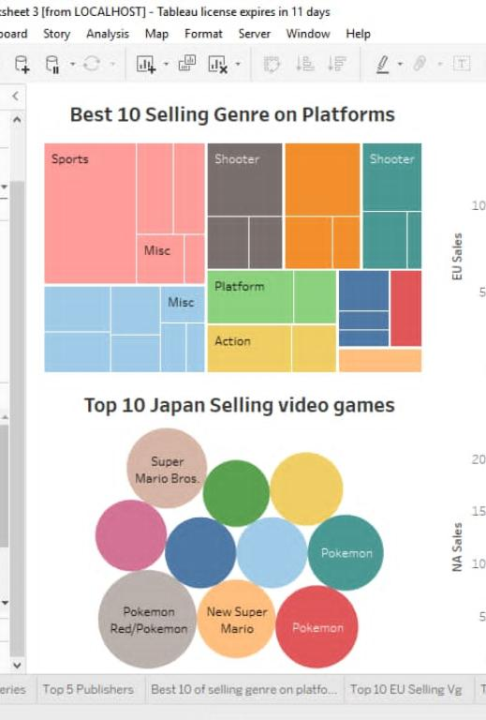

Slide 18
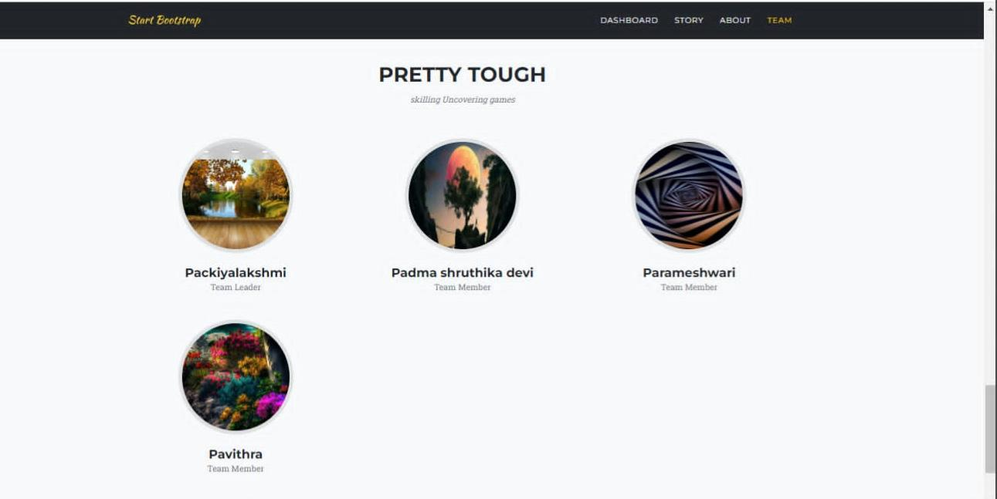
Skilling Uncovering games:

Slide 19
THANK YOU

